Slide 1




Loan Approval Prediction
Project Presentation on

Slide 2
Presentation Outline
Business Problem
Scope and Objective
Process Model (Use case Diagram)
Demonstration
Exploratory Data Analysis
Missing Values & Outlier Treatment
Feature Engineering
Model Building
Conclusion and Future Scope

Slide 3

Problem Statement
Dream Housing Finance company deals in all home loans.
Time Taking : Customer first apply for home loan after that company validates the customer eligibility for loan.
What company knows?
Customer details like Gender, Marital Status, Education,
Number of Dependents, Income, Loan Amount, Credit History and others.
What company wants?
Company wants to automate the loan eligibility process based on customer details provided while filling online application form.

Slide 4
Scope and Objective
The prime objective of our project is very clear from the project title itself. We want to predict whether an applicant can be approved of a desired loan from the bank or not by applying machine learning techniques.
Learn to analyze given data by performing exploratory data analysis.
Learn to deal with missing data and treat Outliers.
Understand and perform Feature engineering.
Go through different Machine Learning algorithms and understand how they work.
Finally build a Machine Learning Model to predict loan approval.

Slide 5
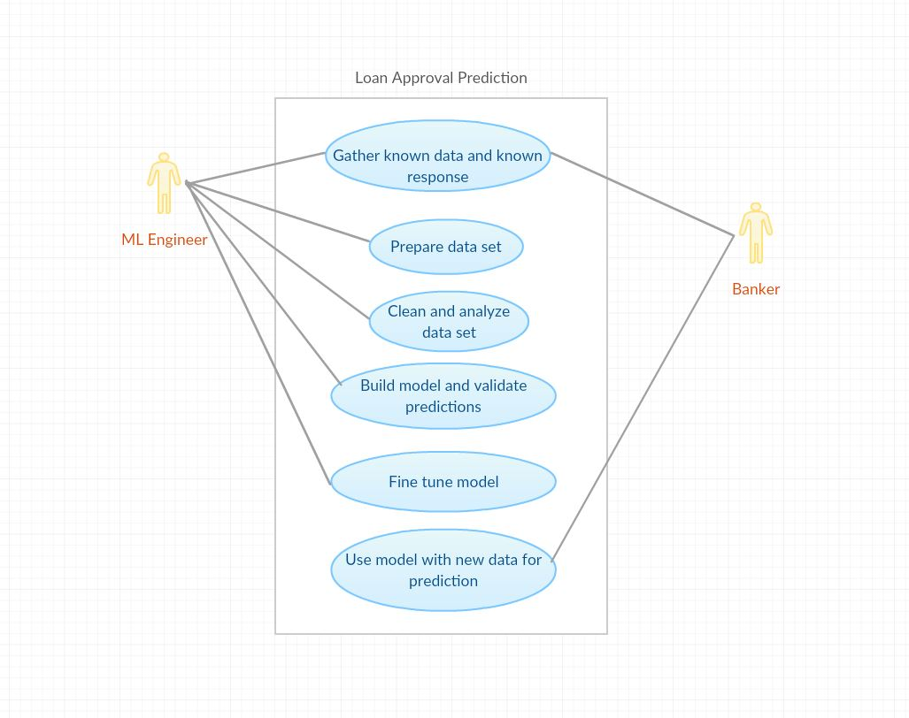
Process Model
Use Case Diagram for Loan Approval Prediction

Slide 6

Demonstration
Sample code and their output

Slide 7
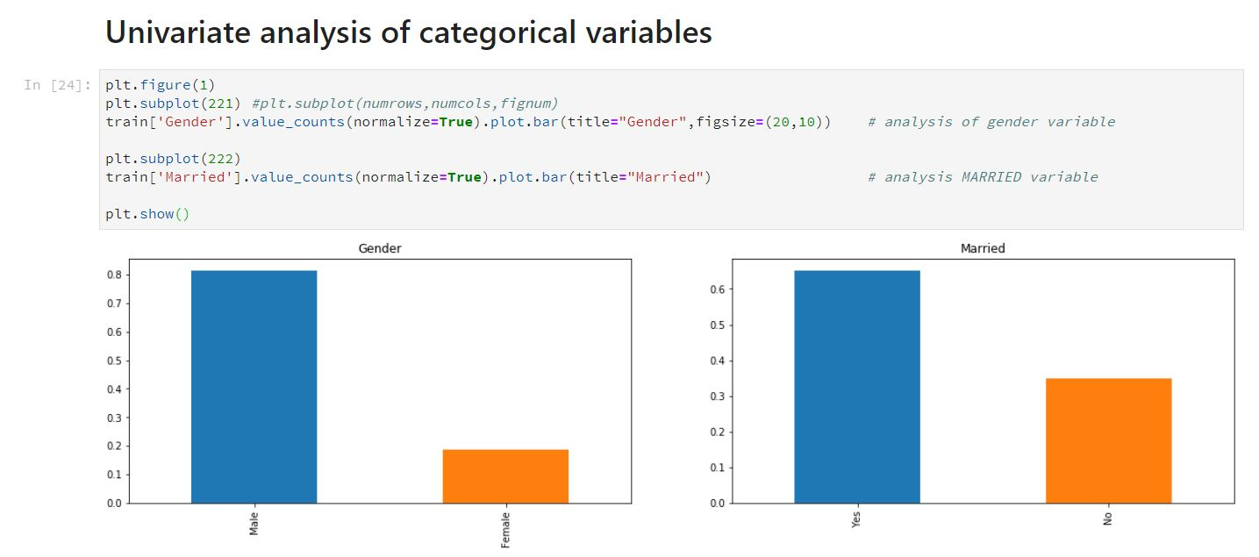
Univariate Analysis
Around 80% of the applicants were male.
Around 65% applicants were married.

Slide 8
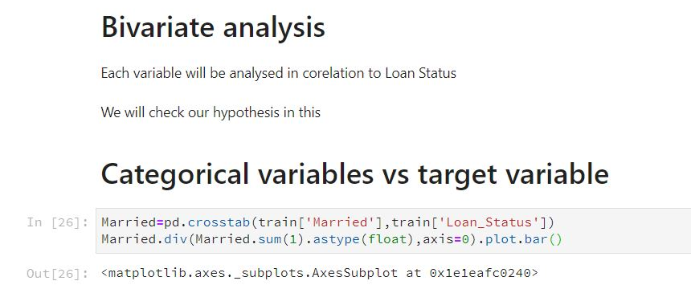
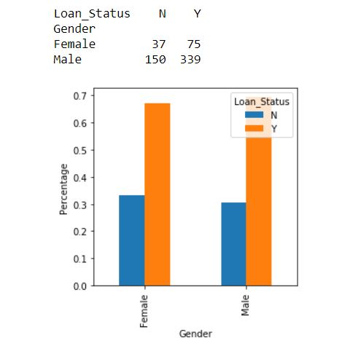
Bivariate analysis
Married Applicants have a higher rate of loan approval compared to unmarried.

Slide 9
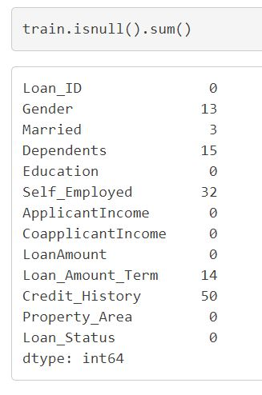
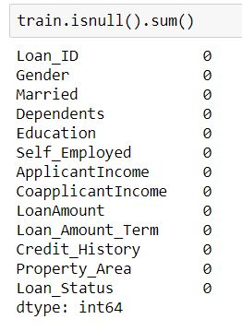
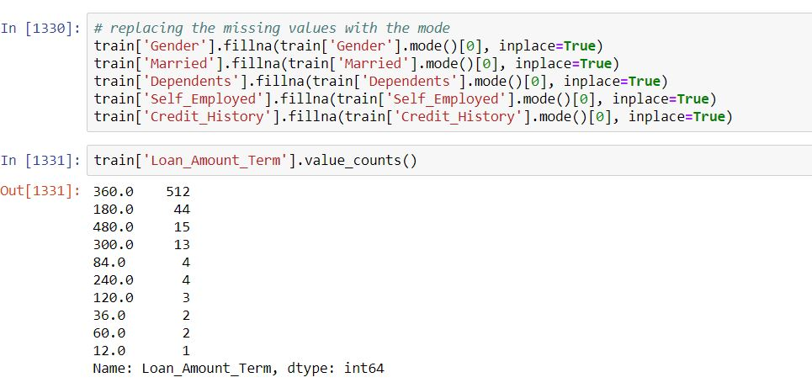
Missing Value Imputation
For numerical variables: imputation using mean or median
For categorical variables: imputation using mode

Slide 10
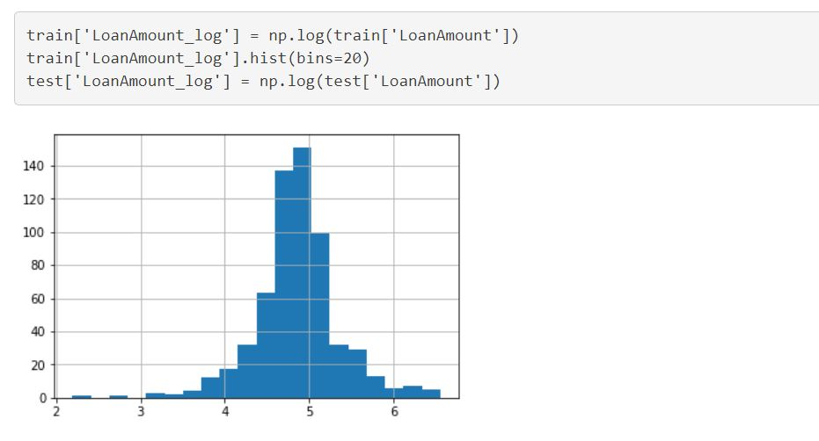
Outlier Treatment
As we take the log transformation, it does not affect the smaller values much, but reduces the larger values. So, we get a distribution similar to normal distribution.

Slide 11
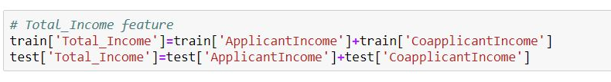


Feature Engineering
Total Income
EMI
Balance income

Slide 12
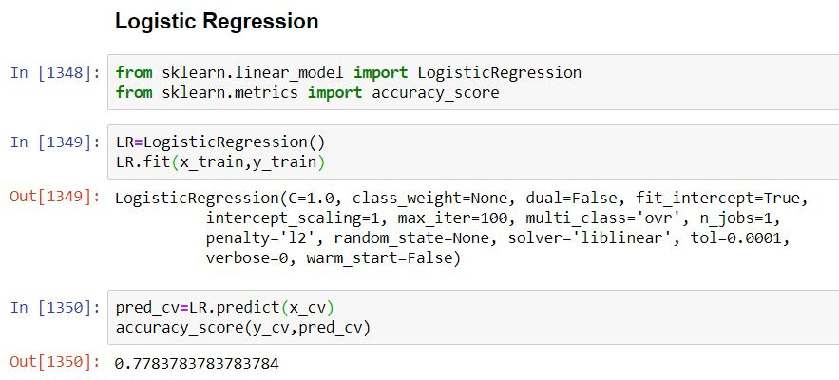
Model Building: Logistic Regression

Slide 13
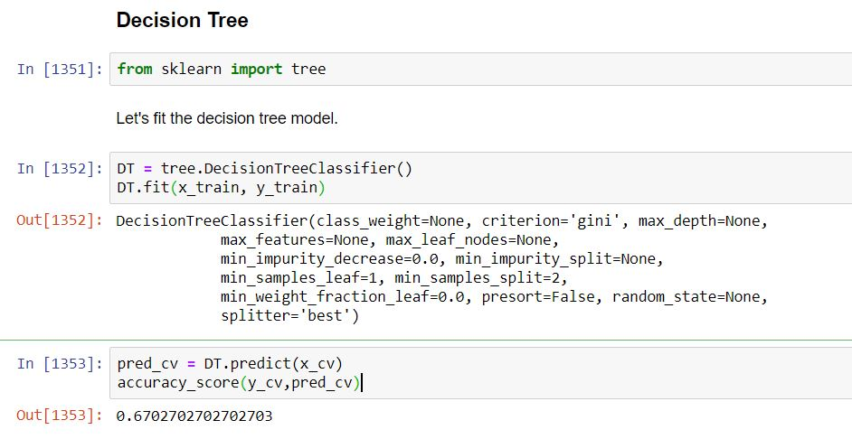
Decision Tree

Slide 14
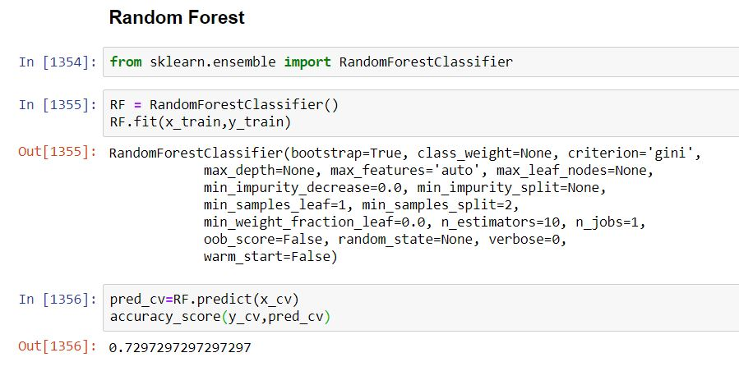
Random Forest

Slide 15
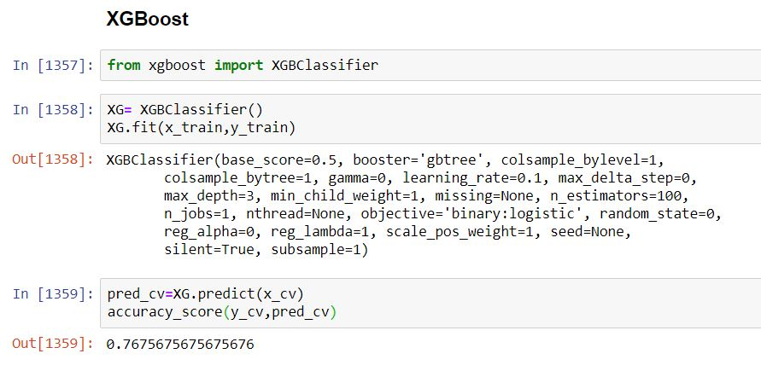
XGBoost

Slide 16
Conclusion and Future Scope
Out of all the classification algorithms used on the dataset, Logistic Regression algorithm gives the best overall prediction accuracy.
Credit History, Balance Income, Property Area are the most important factors for predicting the class of the loan applicant.
We can optimize the hyper parameters of our model and improve the accuracy.
An app with proper UI can be built, which will take various inputs from the user like income, loan amount, loan duration, etc. and give a prediction of whether their Loan application can be approved by the banks.

